Slide 2

19CS2109
Computer Networks And Security
ELEMENTARY DATA LINK PROTOCOLS

Slide 3
WHAT IS A PROTOCOL?
The set of rules and regulations is called a Protocol.
That provide smooth and reliable transmission of frames between nodes. In networking, a frame is a unit of data.
Frames also help to determine how data receivers interpret a stream of data from a source.
Nodes are devices or data points on a larger network.

Slide 4
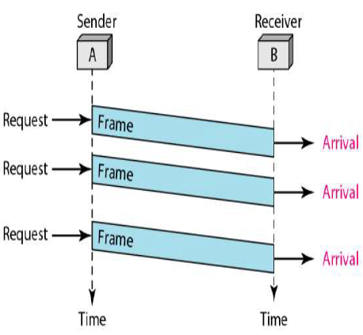
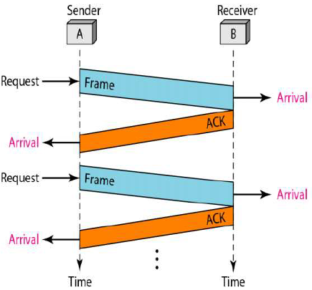
NOISELESS CHANNELS
Let us first assume we have an ideal channel in which no frames are lost, duplicated, or corrupted. We introduce two protocols for this type of channel.
Simplest Protocol
Stop-and-Wait Protocol

Slide 5
FLOW AND ERROR CONTROL
The most important responsibilities of the data link layer are flow control and error control. Collectively, these functions are known as data link control.
Flow control refers to a set of procedures used to restrict the amount of data that the sender can send before waiting for acknowledgment.
Error control in the data link layer is based on automatic repeat request, which is the retransmission of data.

Slide 6
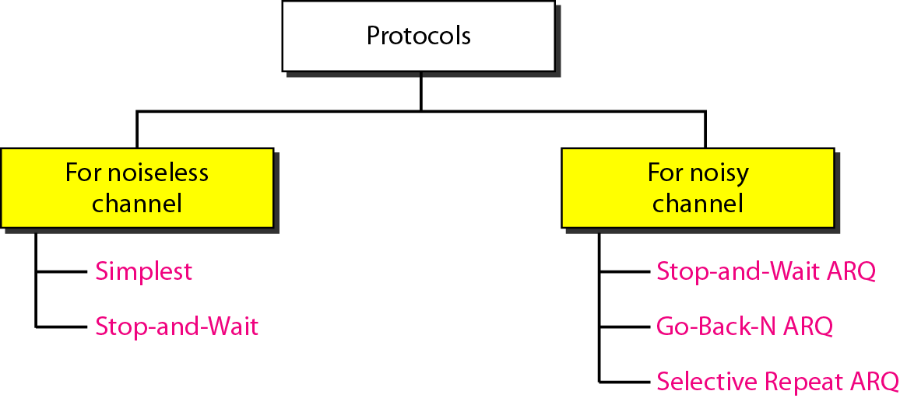
The data link layer can combine framing, flow control, and error control to achieve the delivery of data from one node to another. The protocols are normally implemented in software by using one of the common programming languages. To make our discussions language-free, we have written in pseudocode a version of each protocol that concentrates mostly on the procedure instead of delving into the details of language rules.
Sliding window protocol : allows the sender to send multiple frames before needing the acknowledgements.

Slide 7
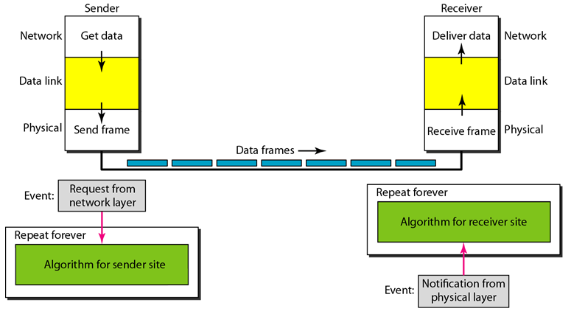
The design of the simplest protocol with no flow or error control

Slide 8
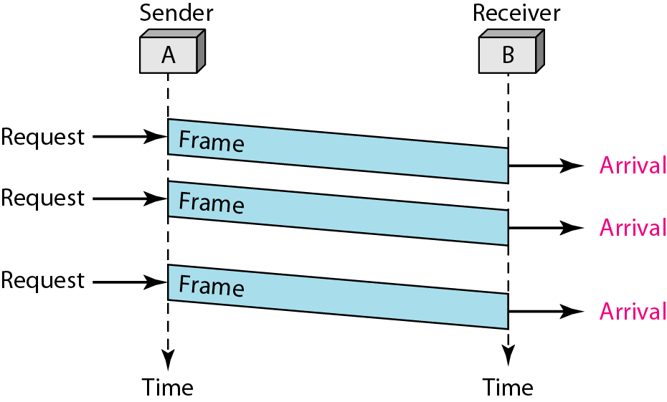
Figure shows an example of communication using this protocol. It is very simple. The sender sends a sequence of frames without even thinking about the receiver. To send three frames, three events occur at the sender site and three events at the receiver site. Note that the data frames are shown by tilted boxes; the height of the box defines the transmission time difference between the first bit and the last bit in the frame.

Slide 9
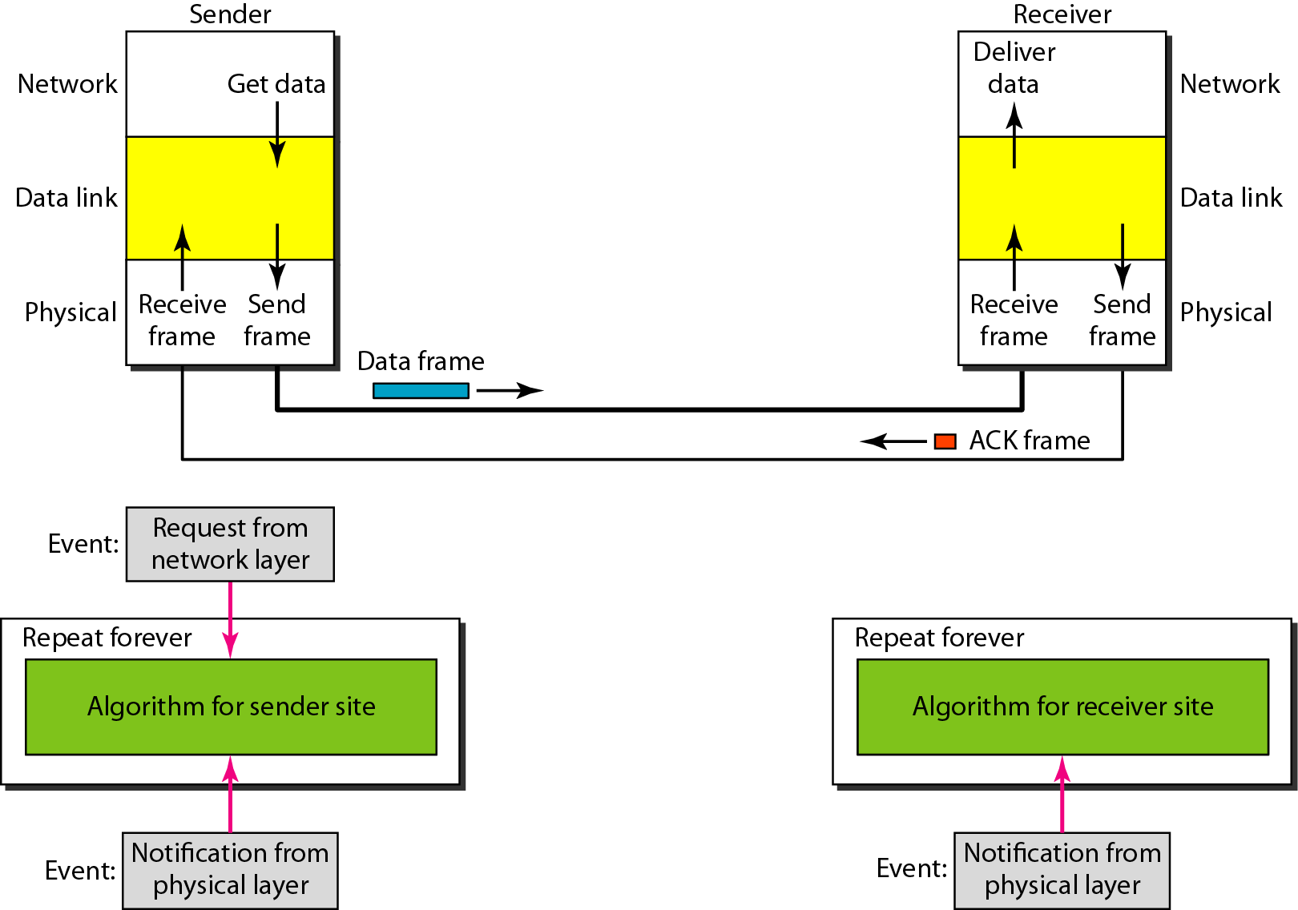
Design of Stop-and-Wait Protocol

Slide 10
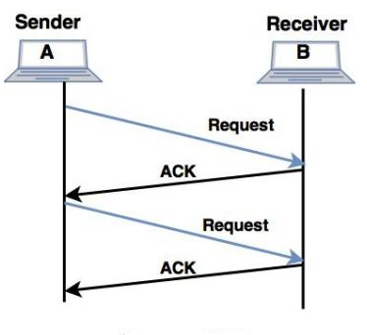

Slide 11
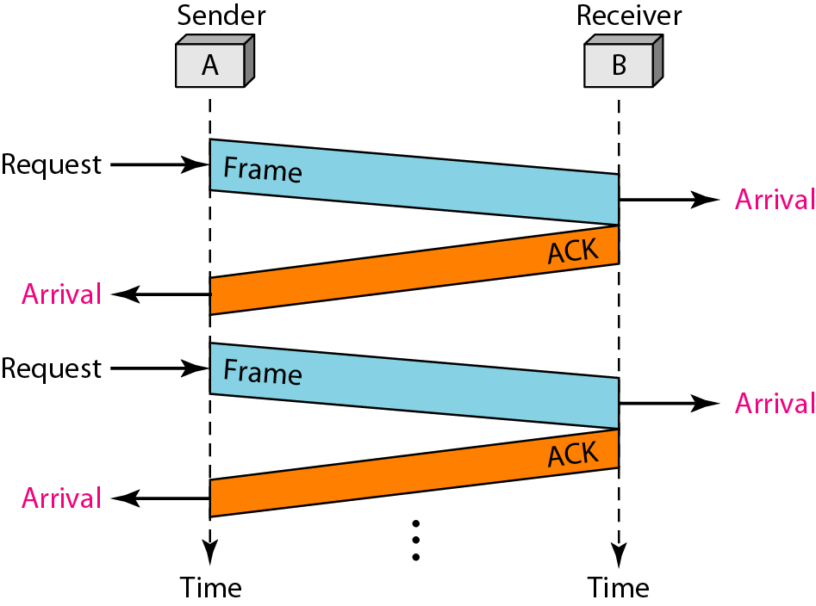
Figure shows an example of communication using this protocol. It is still very simple. The sender sends one frame and waits for feedback from the receiver. When the ACK arrives, the sender sends the next frame. Note that sending two frames in the protocol involves the sender in four events and the receiver in two events.

Slide 12
NOISY CHANNELS
Although the Stop-and-Wait Protocol gives us an idea of how to add flow control to its predecessor, noiseless channels are nonexistent. We discuss three protocols in this section that use error control.
Stop-and-Wait Automatic Repeat Request
Go-Back-N Automatic Repeat Request
Selective Repeat Automatic Repeat Request

Slide 13
Note :
Error correction in Stop-and-Wait ARQ is done by keeping a copy of the sent frame and retransmitting of the frame when the timer expires.
In Stop-and-Wait ARQ, we use sequence numbers to number the frames.
The sequence numbers are based on modulo-2 arithmetic.
In Stop-and-Wait ARQ, the acknowledgment number always announces in modulo-2 arithmetic the sequence number of the next frame expected.

Slide 14
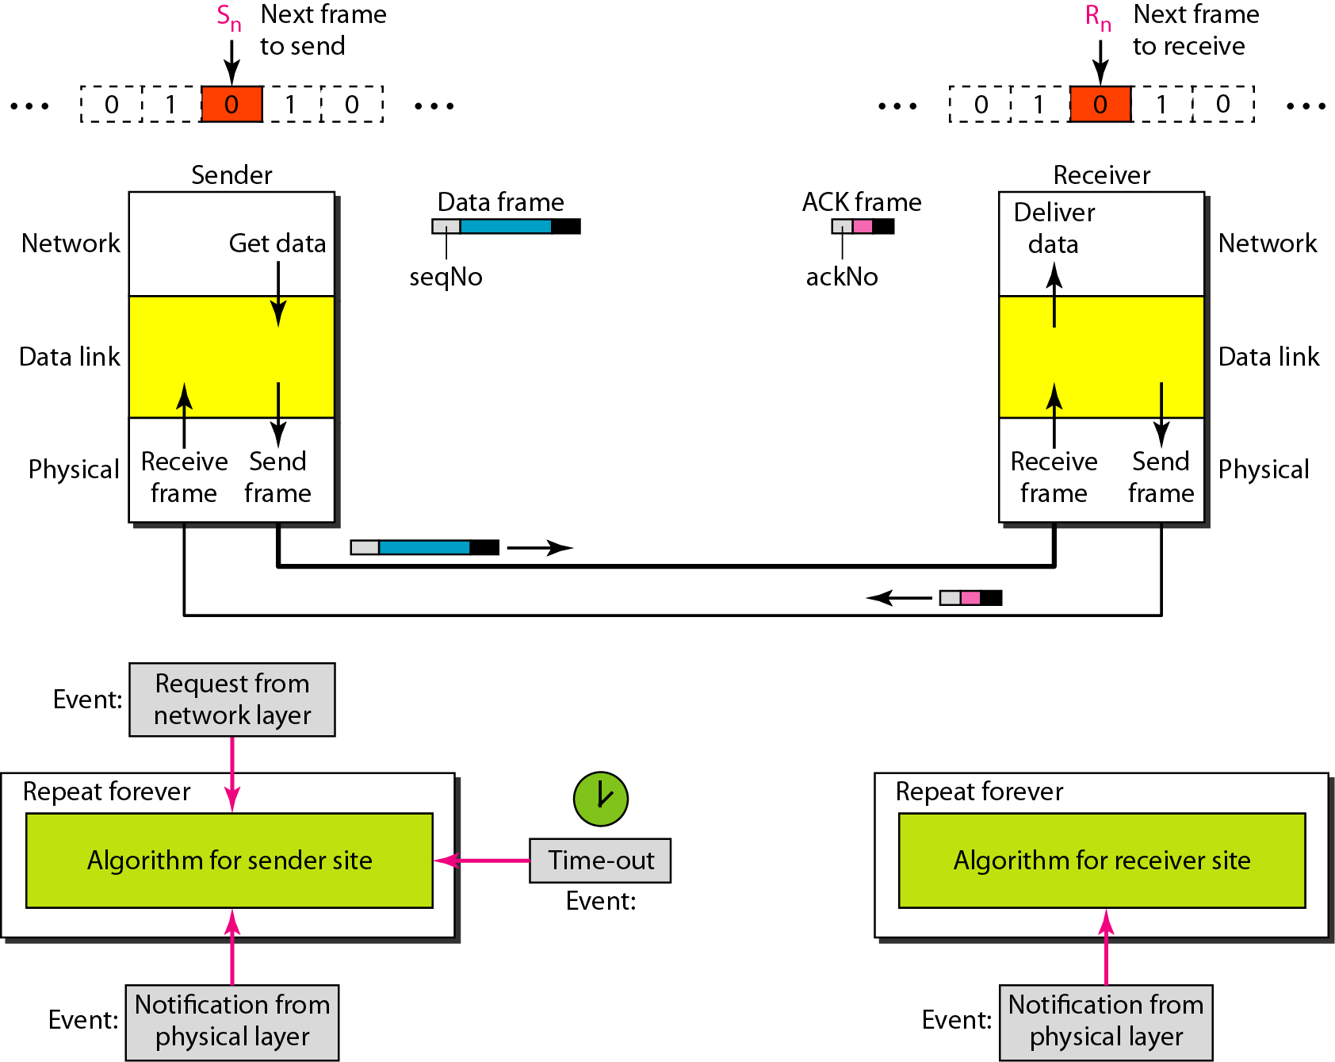
Design of the Stop-and-Wait ARQ Protocol

Slide 15
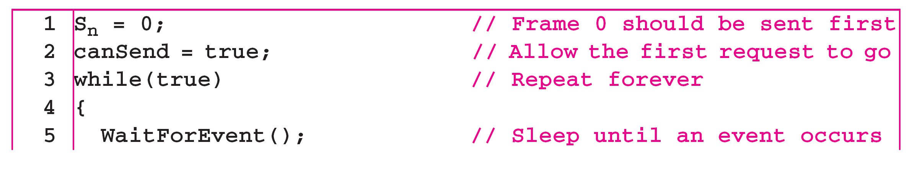

Slide 16
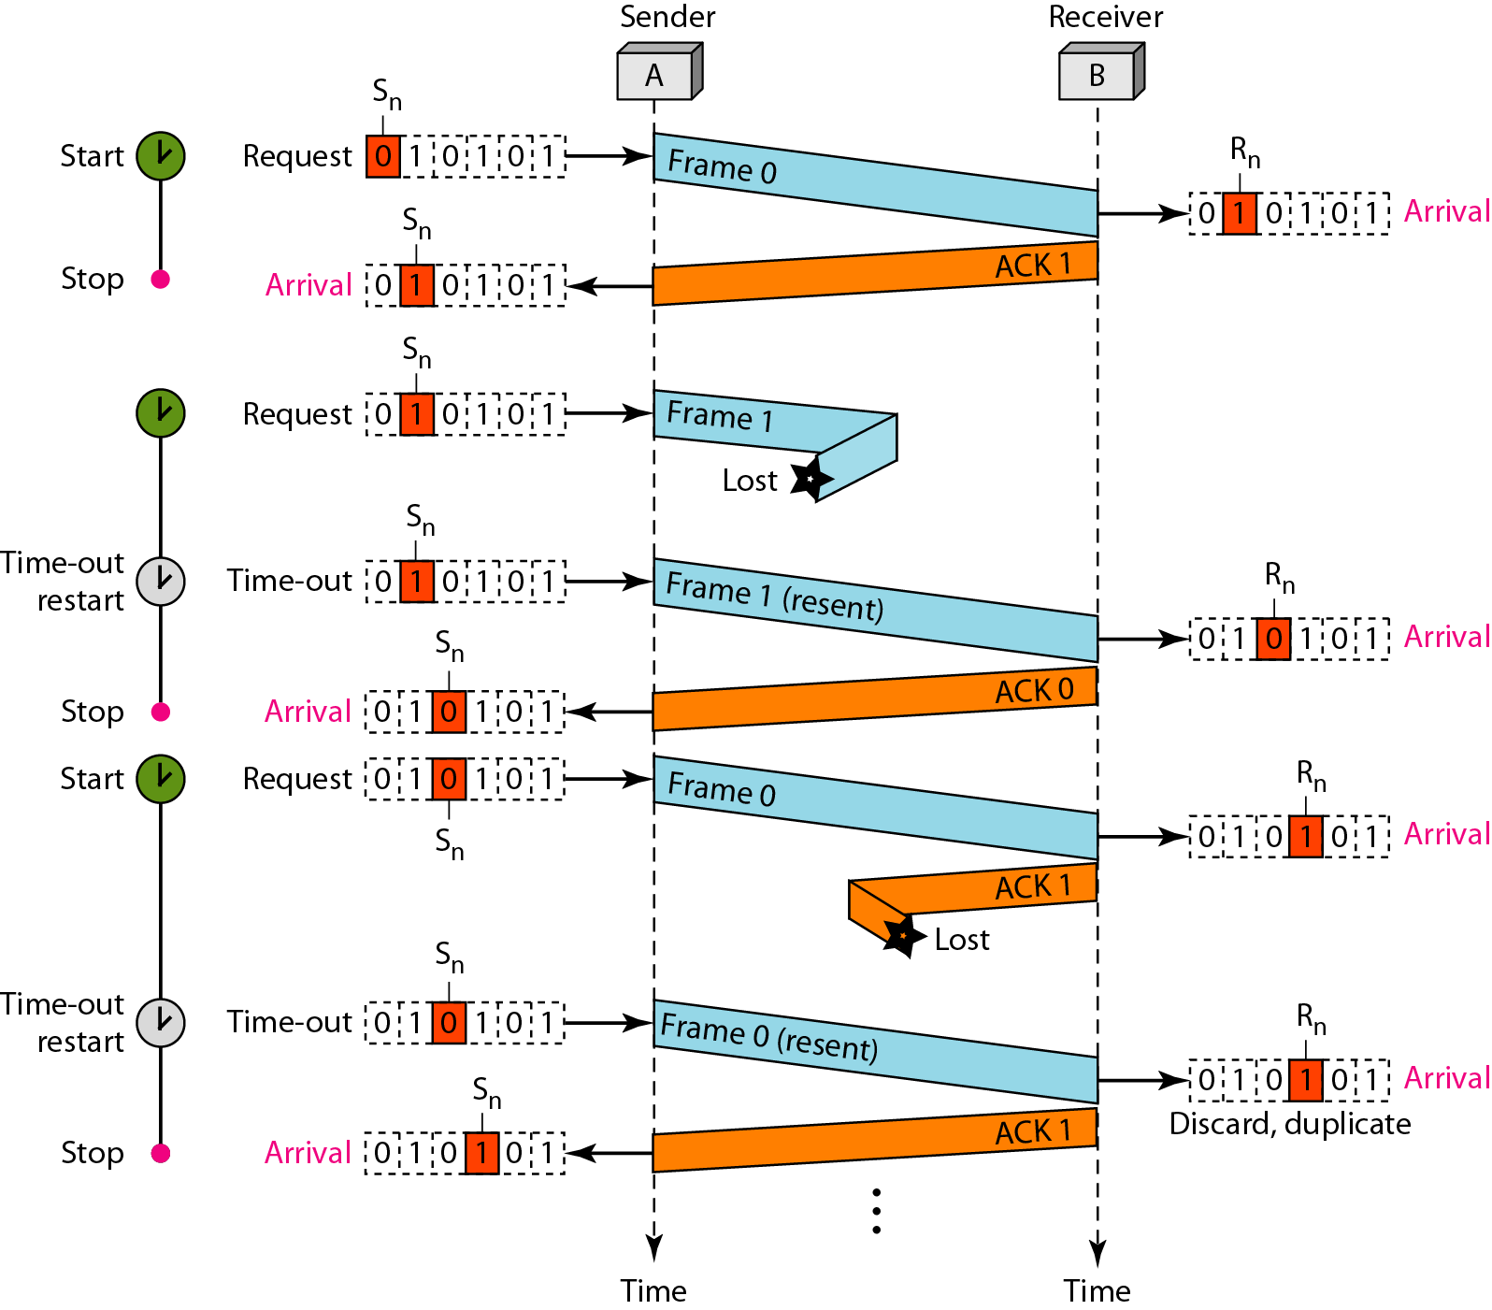
Figure shows an example of Stop-and-Wait ARQ. Frame 0 is sent and acknowledged. Frame 1 is lost and resent after the time-out. The resent frame 1 is acknowledged and the timer stops. Frame 0 is sent and acknowledged, but the acknowledgment is lost. The sender has no idea if the frame or the acknowledgment is lost, so after the time-out, it resends frame 0, which is acknowledged.

